Slide 1

Capturing moments for Generation Z
Michelle Cao, Celina Chen, Angel Ho, Katie Yang
NAMES

Slide 2
Research Approach
Research Approach
A blend of primary and secondary research methods were used to develop an understanding of GoApe and the market landscape
GoApe materials
industry reports
industry trends
market benchmarks
Secondary
exploratory
qualitative
15+ interviews
Primary
consumer preferences
50+ survey responses
quantitative
Notes:
Possible Alternative:
Opportunity on one side

Slide 3
Situational Analysis
Situational Analysis
GoApe must adapt to external trends facing experience-based products
Competitors
Potential for greater course variety
Growing competition in the field with few differentiating factors
Opportunities to introduce new courses catered towards disabled people or other groups
Limited expansion opportunities
Insert Tagline
Growing digitization
Limited by the environment surrounding each course
Increasing presence and expectation of technology in the consumer experience
Complexity of planning
Shift from consumption to experience
Gen Z customers prefer going on trips based on ease of planning
Gen Z consumers are more attracted to experiences rather than materialism
Notes:
Possible Alternative:
Opportunity on one side

Slide 4
Company Analysis
Appendix A: Company Analysis
GoApe and the adventure course industry is facing many changes in the digital age
Strengths
S
W
-Locations in 15 different states
-Cater to different skill levels
-Strong narrative of social impact
Strengths
Weaknesses
Weaknesses
-Operations are restricted by season/weather
-Only a few select locations offer multiple courses
-Located in areas that aren’t known to be popular tourist spots
Opportunities
Threats
Opportunities
-Potential to expand variety of courses
-Expand partnership base outside of state governments and parks
O
T
Threats
-Many similar competitors
-Expansions are limited by physical space and capacity
-Competitors have more unique courses (tech, location, etc.)

Slide 5






Perceptual Map
Situational Analysis
GoApe must adapt to external trends facing experience-based products
Tech-Enabled
Tech-Enabled
Niche
General
Niche
General
Traditional
Traditional
Current State
Future State
Notes:
Possible Alternative:
Opportunity on one side

Slide 6
Problem Statement
Problem Statement
GoApe is disconnected from the consumer in terms of creating the initial awareness of the brand and generating retention for consumers
Reach new heights
Relive your experiences
How can leverage its unique position at the intersection of nature and entertainment to succeed in creating an adventurous experience for consumers?
Notes:
Possible Alternative:
Opportunity on one side

Slide 7
Strategy Objectives
Proposed Solution
Target and increase GoApe’s exposure in Generation Z
Drive awareness of GoApe’s brand
Improve customer experience
Increase word-of-mouth outreach
Pillar 1: Reach
Broaden GoApe’s consumer base
Pillar 2: Explore
An improved and more customer-focused experience through integration of technology
Pillar 3: Relive
Create a post-experience culture to utilize retained customers and drive awareness

Slide 8
CAPTURE YOUR MOMENT
Brand Strategy

Slide 9
Pillar 1:
Pre-Sale: Reach

Slide 10

Social Media VR/360° Ads
Pre-Sale Pillar: Overview & Tactic
Creating an immersive online advertising tactic to emulate experiential product
of Millennials prefer to spend on experiences over things¹
Generate a stronger understanding of GoApe’s selling proposition
Implement GoApe app technology into 360° video ads of courses
72%
300%
increase in CTR for interactive ads over regular ads²
Impact:
Increases revenue via higher click through rate
Elicit longer and emotional engagement with content
Preparation for future shift to VR/AR technology
¹Harris Group, ²Omnivirt

Slide 11

Seasonality
Pre-Sale Pillar: Overview & Tactic
Taking advantage of GoApe’s natural scenery to market to Gen Z customers
68%
Leveraging natural scenery to create a trend unique to GoApe
Using Big Data to calculate weather trends that correspond with scenery changes
Of Gen Z customers post on social media when they have nice pictures
40%
Of Gen Z customers engage in outdoor activities when the weather is nice
Impact:
Creates incentive to travel for new customers
Increases online traffic on GoApe website
Increases retention rate through ease of planning
New York Times, Expedia Group Media Solutions

Slide 12
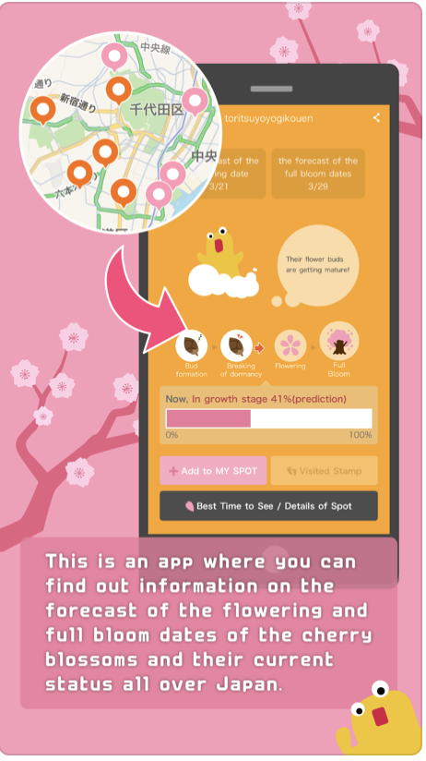


Case Study: Sakura Navi
Pre-Sale Pillar: Tactic Case Study
App forecasting & tracking cherry blossom blooming times by location
Background: Japan Meteorological Corporation (JMC)
Method:
Announce estimations
Notifications
Posts estimated dates of flowering & full bloom at 1000+ cherry blossom locations
Users can receive notifications about selected spots
Impact:
JMC’s Cherry Blossom Forecast App topped Hong Kong’s
Paid app charts with 2 million downloads for 2 years

Slide 13
Pillar 2:
Point-of-Sale: Explore

Slide 14


RFID Photography Technology
Point-of-Sale Pillar: Overview & Tactic
Automated photo system that enables users to easily view and share experiences
RFID tags embedded into items worn by participants
1.
60% of all travelers and 97% of Millennials share their trip photos¹
User-generated content inspires more people to attend an event or attraction they had not considered before
Sensors enable strategically placed cameras and motion triggers to automatically capture and sort images
2.
Photos and RFID information are immediately uploaded, customers find their images via tag number
3.
Impact:
Capture high-quality photos without distracting guests from their experience
Photos can be easily and immediately shared and uploaded
Simultaneously generate content for digital activation and social media
¹Olapic Inc.

Slide 15
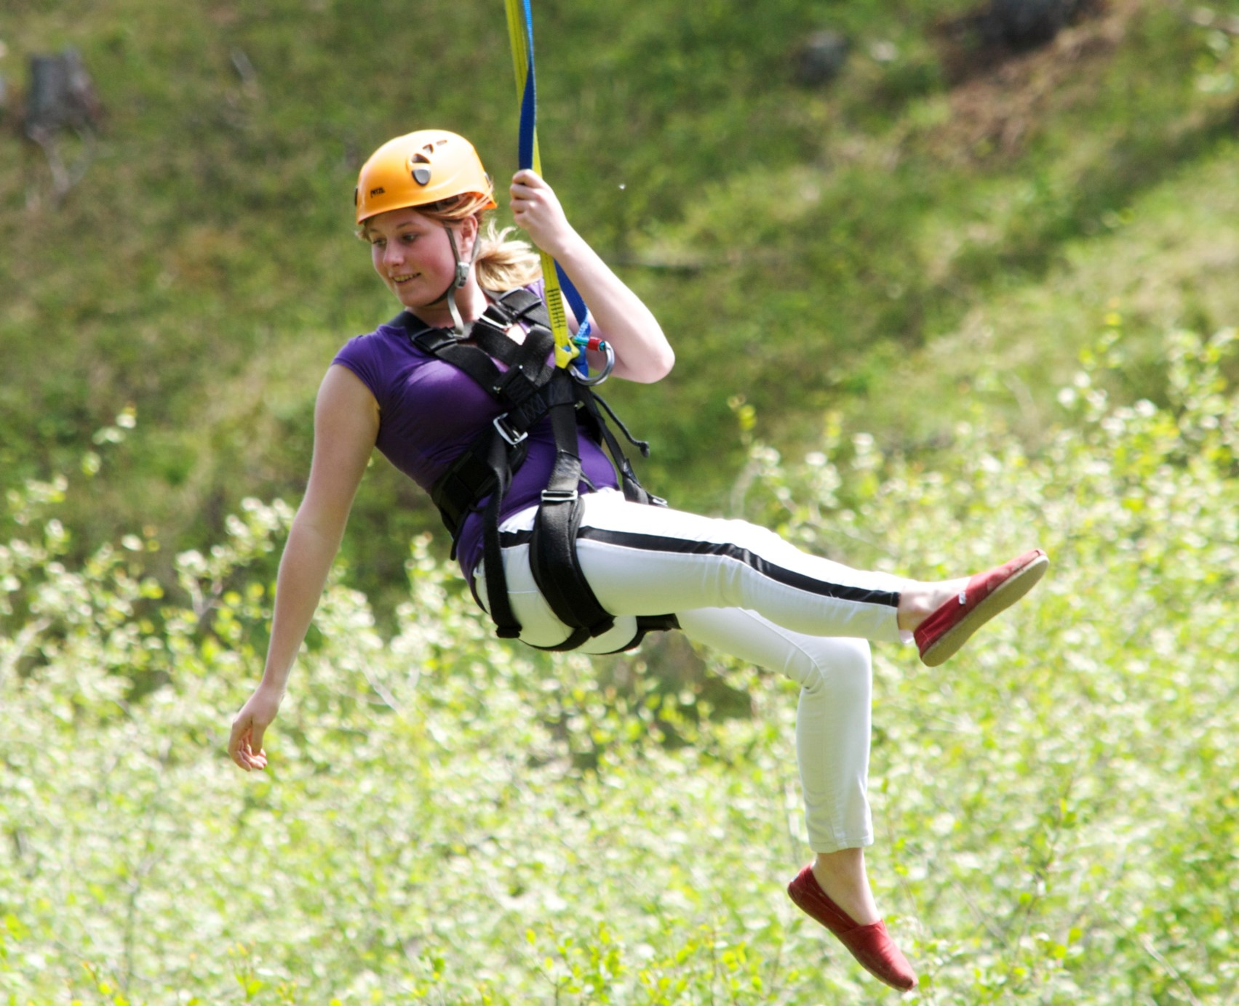
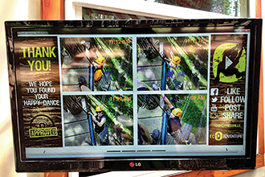
Case Study: Cypress Hill Eco-Adventures
Point-of-Sale Pillar: Tactic Case Study
Meeting consumer demand for high-quality, shareable photos
Background: Adventure park in Saskatchewan, Canada
Method:
System Implementation
Frictionless Process
Partnered with Fotaflo to install RFID sensors and cameras along ziplines and other photo-ops
Photographs distributed such that they are easily accessible and shareable
Impact:
Before the photo system, Cypress Hills had12% return and 10% word-of-mouth customers. After a year with the photography technology, the park saw 28% return and 36% word-of-mouth customers.

Slide 16
Pillar 3:
Post-Sale: Relive

Slide 17
Overview of Tactics
Tactic Overview
While other tactics were considered, the four selected were most impactful
High
Feasibility
Rewards Program
Seasonality
Web Extension
Social Media Sharing
Brand Ambassadors
TV Ads
VR/360°
Advertisements
Merch
Giveaways
RFID Photos
School Partnerships
Age Expansion
Lifestyle blog partnership
Deep Discounts
Photo-stands
YouTube Partnerships
Transportation Partnerships
Video Games
Low
Feasibility
AR Goggle Implementation
100% DTC
Low Impact
High Impact

Slide 18
Insert
Implementation Timeline
Insert
2019
Launch
Maintenance
Blitz
Maintenance
2024
PILLAR
TACTIC 1
TACTIC 2
PILLAR
TACTIC 1
TACTIC 2
PILLAR
TACTIC 1
TACTIC 2

Slide 19
Budget
Budget
Insert

Slide 20
Reach new heights
Relive your experiences
REACH
EXPLORE
REACH
BROADEN GOAPE’S CONSUMER BASE
EXPLORE
AN IMPROVED AND MORE CUSTOMER-FOCUSED
EXPERIENCE THROUGH INTEGRATION OF TECH
RELIVE
CREATE A POST-EXPERIENCE CULTURE TO UTILIZE
RETAINED CUSTOMERS AND DRIVE AWARENESS
RELIVE

Slide 21
GoApe will attract new customers and build lasting connections with returning participants
Problem
How can GoApe enhance customer experience as a means of increasing brand awareness and word-of-mouth advocacy?
Drive awareness to increase consumer base
Key Issues
Lack of brand awareness
Limited incorporation of technology into marketing strategies
Suboptimal retention rates
Outcomes
Word-of-mouth interaction inspired by social media activity
Strategy
Capturing Your Moment
Tactics
Reach
Creation of a customer loyalty loop
Explore
Relive

Slide 22
Thank you!

